Slide 1
CPS 235 Object Oriented Programming Paradigm
Lecturer Aisha Khalid Khan
Classes (Part II)
CPS235:Classes

Slide 2
Contents
static class data and member functions
const member functions and objects
Destructors
References
Copy Constructor
CPS235:Classes

Slide 3
Static Class Data
Each object created has its own separate data
But all objects in a class use the same member functions since the functions for each object are identical
The member functions are created and placed in memory only once where they are defined
However if a data item in a class is declared as static, then only one such item is created for the entire class no matter how many objects are created
Visible only within the class but lifetime is the entire program
CPS235:Classes

Slide 4
Static Class Data
class foo
{
private:
static int count; //declaration only
public:
foo()
{ count++; }
int getCount()
{ return count; }
};
int foo::count = 0;//definition outside the class
int main()
{
foo f1,f2,f3;
cout<<f1.getCount()<<f2.getCount()<<f3.getCount();return 0;
}
CPS235:Classes

Slide 5
Static Member Functions
Defined using the keyword static
Function call is made with the scope resolution operator thus associating the function to the class rather than to a particular object
Nonstatic member functions can access the static variables (int getCount() ) in the previous example
However, a static member function cannot access nonstatic data
CPS235:Classes

Slide 6
Static Member Functions
class foo
{
private:
static int count; //declaration only
public:
foo()
{ count++; }
static int getTotalCount()
{ return count; }
};
int foo::count = 0;//definition outside the class
int main()
{
foo f1,f2,f3;
cout<<“Total Count:”<<foo::getTotalCount()<<endl;
return 0;
}
CPS235:Classes

Slide 7
const member functions
A const member function ensures that it will not modify any of the class member data
The const keyword should be used in both the declaration (if any) and the definition of the function body
Member functions that do nothing but acquire data from an object (for instance the display or show functions) are candidates for being made const
void showdist ( ) const
{
cout <<feet << “ \‘ –” << inches <<“\” “;
}
CPS235:Classes

Slide 8
const member functions
class aClass
{
private:
int a;
public:
void nonConst_Func ( ) //non const function
{ a = 100;}
void const_Func ( ) const //const function
{ a = 100;} // Error :can’t modify a member
};
CPS235:Classes

Slide 9
const member function arguments
If an argument is passed to a function by reference, and you do not want the function to modify it, the argument should be made const in the function declaration and definition
Distance add_dist(const Distance& d2) const
{
Distance temp;
//d2.feet=0; //ERROR: can’t modify d2
//feet =0; //ERROR: can’t modify this
temp.inches = inches + d2.inches;
if (temp.inches >= 12.0)
{ temp.inches -= 12.0;
temp.feet=1;
}
temp.feet += feet + d2.feet;
return temp;
}
CPS235:Classes

Slide 10
Common Programming Errors
Defining as const a member function that modifies a data member of an object is a compilation error
Defining as const a member function that calls a non-const member function of the class on the same instance of the class gives a warning message
Invoking a non-const member function on a const object gives a warning message
CPS235:Classes

Slide 11
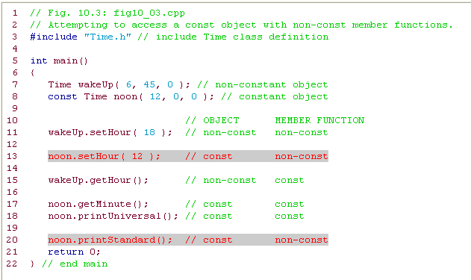
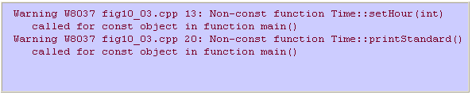
Using const
CPS235:Classes

Slide 12
Class Destructors
Destructors are usually used to deallocate memory and do other cleanup for a class object and its class members when the object is destroyed
Same name as the class but preceded by a tilde (~)
Has no arguments and no return type
class X {
private:
int x;
public:
X():x(0){} // Constructor for class X
~X(){} // Destructor for class X
};
CPS235:Classes

Slide 13
References

Slide 14
What is a Reference?
A reference is an alias
When you create a reference, you initialize it with the name of another object, the target
Then the reference acts as an alternative name for the target
  Any changes made to the reference are actually being performed on the target
References CANNOT be reassigned
CPS235:Classes

Slide 15
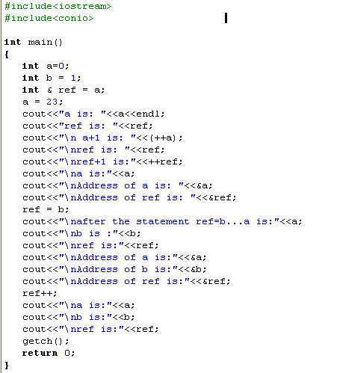
CPS235:Classes

Slide 16

CPS235:Classes

Slide 17
Using References
ref is an alias to a
ref does not hold its own int value
It is just another way to get at the int value stored in a
Syntax
Data Type of value to which reference will refer
Reference operator (&)
Alias i.e., the name of the reference
Equal to (=)
Variable to which the reference will refer i.e., the name of the target object

Slide 18
Important while using References
Because a reference must always reference to another value, you must initialize a reference when you create it
If you don’t, you will get a compiler error
int & ref ; //ILLEGAL
A reference always refers to value with which you initialized it
You cannot reinitialize a reference to another value
References to Objects of a Class can be created in the same way
  Distance dist1(10,5.5);
  Distance & ref_dist = dist1;

Slide 19
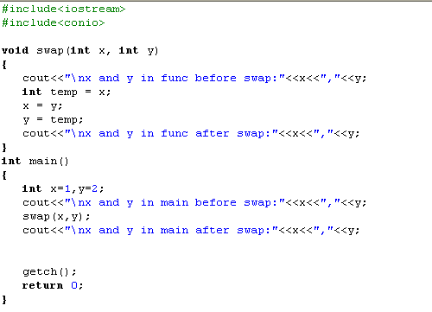
What would be the output?
CPS235:Classes

Slide 20
Why pass by reference?
Passing by reference is efficient because you don’t make a copy of the argument variable
  You provide access to original variable through a reference
  The function will modify the actual data which has been passed by reference
Since objects can be very large, unnecessary copies waste memory space
  Creating a copy of an object is not as straightforward as creating a copy of a variable of basic data type
  The default copy constructor is implicitly called by the compiler when an object is passed by value

Slide 21
Copy Constructor
When is it used?
Programmer can use copy constructor explicitly to create an object that is a copy of an existing object
Compiler generates a call to copy constructor, when object is passed as a value parameter
By default, the compiler generates a copy constructor for each class
  This default copy constructor makes a copy of an object member by member
If a class has dynamic data members this copy constructor generated by the compiler is not adequate as we’ll see in later chapters
  Then the programmer needs to write a proper copy constructor
CPS235:Classes

Slide 22
The Default Copy Constructor
void main()
{
  Distance dist1(10,5.5);
  Distance dist2(dist1);//causes the default copy constructor to perform a member-by-member copy of dist1 into dist2
  Distance dist3 = dist1;//has the same effect as the above statement
}
CPS235:Classes

Slide 23
Making your own copy constructor
#include<iostream>
#include<conio>
class foo
{
private:
static int count;
int id;
public:
foo():id(0)
{ count++; }
foo(int i):id(i)
{ count++; }
static int getTotalCount()
{ return count; }
void display()
{ cout<<"object id:"<<id; }
foo(const foo&);// copy constructor
};
CPS235:Classes

Slide 24
Making your own copy constructor
int foo::count = 0
foo::foo(const foo& f):id(f.id)
{
count++;
}
int main()
{
foo f1;
foo f2(1);
foo f3(2);
foo f4(f3); //will not change count to 4 if default copy constructor is called
f1.display();
f2.display();
f3.display();
f4.display();
cout<<"Total Count:"<<foo::getTotalCount()<<endl;
getch();
return 0;
}
If you do not make your own copy constructor in this case, then the count variable will not be updated if the default copy constructor is called
CPS235:Classes

Slide 25
Making your own copy constructor
A 0ne-argument constructor which has the same name as the class and no return type
The argument is always an object of the same class
The argument must be passed by reference
  If it is passed by value, then automatically the copy constructor is called to create a copy which means the constructor will call itself to make a copy and this process runs an infinite number of times
The argument should be constant
  An important safety feature since you do not want to modify the data of the object being passed to the constructor
CPS235:Classes

Slide 26
Compulsory Reading
Robert Lafore, Chapter 6: Objects and Classes
Robert Lafore, Chapter 4, Topic: Enumerations
CPS235:Classes

